Slide 1
STEGANOGRAPHY
… the art of Hiding Information
ANKITA GUPTA
Computer Science
3rd Year, Sec-A
11900113011

Slide 2
STEGANOGRAPHY
Derived from the Greek words, Steganos (Covered) & Grapto (Writing)
Practice of hiding private or sensitive information within something
that is usually not suspected
Steganography in the modern day sense refers to information or a
file that has been concealed inside a digital Picture, Video or Audio file
Science of hiding information in such a way that no one suspects the
information exists
Steganography is usually combined with Cryptography
When information or a file is hidden inside a carrier file, the data is
encrypted with a password. Referred as ‘Steganalysis’

Slide 3
HISTORY
Earlier invisible ink was used to write information on pieces of paper
Head of messengers were shaved so, a message could be written on it
Wax tablet was peeled on which message was to be written & refilled
Null cipher sent by the German embassy in World War I
“PRESIDENT'S EMBARGO RULING SHOULD HAVE IMMEDIATE NOTICE. GRAVE SITUATION AFFECTING INTERNATIONAL LAW. STATEMENT FORESHADOWS RUIN OF MANY NEUTRALS. YELLOW JOURNALS UNIFYING NATIONAL EXCITEMENT IMMENSELY.”
(Taking the first letter in each word of message reveals the hidden text.)
“ PERSHING SAILS FROM NY JUNE 1”

Slide 4
TECHNIQUES
STEGANOGRAPHY
PHYSICAL
DIGITAL
NETWORK
PRINTED

Slide 5
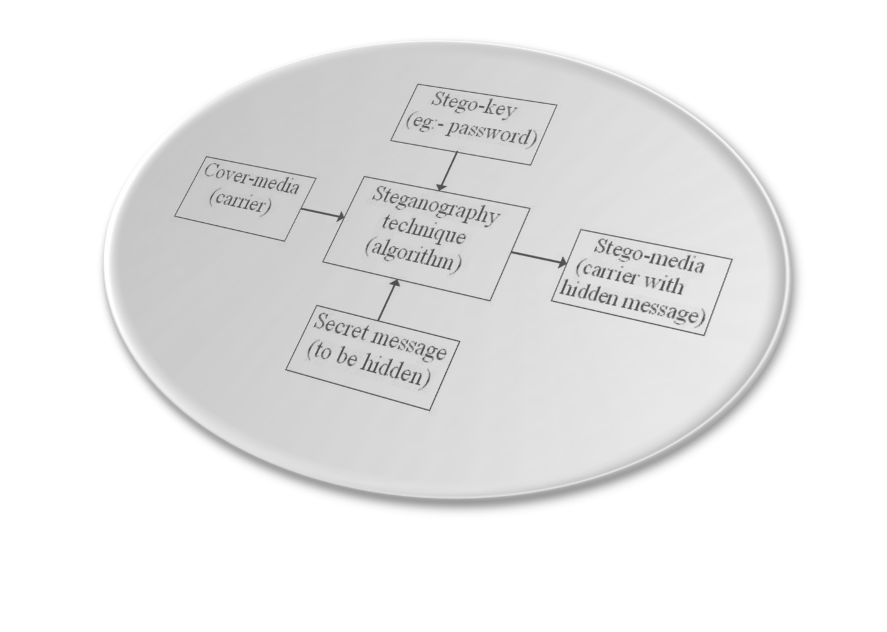
BLOCK DIAGRAM

Slide 6
TERMINOLOGY
Carrier File - A file which has hidden information inside it
Steganalysis - Process of detecting hidden information inside a file
Stego-Medium - The medium in which the information is hidden
Payload - The information which is to be concealed
Redundant Bits - Pieces of information inside a file which can be
overwritten or altered without damaging the file

Slide 7
FLOW CHART
Payload
Carrier
Stegosystem encoder
Channel
or
Medium
KEY
Original
Message
Stegosystem Decoder

Slide 8
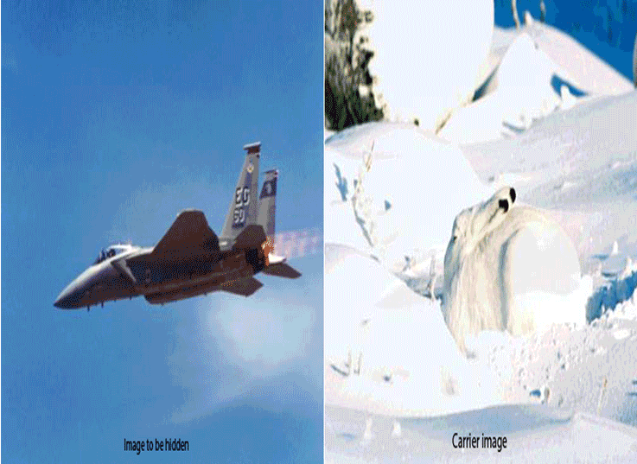
ILLUSTRATION

Slide 9
MATLAB DEMO CODE
DATA HIDING
2. FUCNTION OF HIDETEXT
3. DATA RETRIVAL
4. FUNCTION OF FINDTEXT

Slide 10
OTHER TYPES…
Parity coding
It breaks the sound signal into areas & then hides the message in the parity bit. If parity does not match, it adjusts LSB of one of the samples to get the required parity.
Spread spectrum
It makes use of the fact that small changes are more difficult for the human eye or ear to detect at high energy levels. The message is hidden in those areas of the carrier file with the greatest energy.
BPCS
It is the most efficient. Embedded data can be over 50% the size of the carrier without affecting quality noticeably.

Slide 11
APPLICATION
Modern Printers
Steganography is used by leading manufacturers in digital & laser
printers, including HP and Xerox. Here, tiny yellow dots are added to
each page. The dots are barely visible and contain encoded printer
serial numbers, as well as date and time stamps.
Digital Watermarking
Steganography is used for digital watermarking, where a message is
hidden in an image so that its source can be tracked or verified.
e-mail Spam
e-mail messages is encrypted steganographically. Coupled with
the "chaffing and winnowing" technique, a sender gets messages
out and cover their tracks all at once.

Slide 12
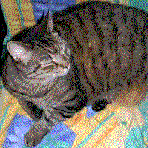
FUTURE APPLICATION
Alleged use by terrorists
An example showing how terrorists may
use forum avatars to send hidden messages.
This avatar contains the message "Boss said,
we should blow up the bridge at midnight."
encrypted with http://mozaiq.org/encrypt
using "växjö" as password.
Alleged use by intelligence services
In 2010, the FBI revealed that the Russian foreign intelligence service
uses customized steganography software for embedding encrypted
text messages inside image files for communicating with illegal agents
stationed abroad.

Slide 13
CONCLUSION
Steganography is the art of hiding sensitive data without generating
unnecessary curiosity and suspision among foreign party
Steganalysis is the technique to detect Steganography
The research to device strong steganographic and steganalysis technique
is a continuous process
With proper usage Steganography can prove to be the ultimate solution
to information hidding.On the contrary, its misuse is devastating and
unthinkable.

Slide 14
THANK YOU ALL
… for your Patient Hearing
Sibaka Mahapatra
Computer Science
3rd Year, Sec-E
0801288242

